Slide 1
Simulation and Modeling
CSE4131_CSE4132

Slide 2
Tests For Random Numbers
Five types of tests:
Frequency test
Runs Test
Autocorrelation test
Gap test
Poker test
Uniformity test
Independence test
Runs up and down
Runs above and below the mean.
Runs test: length of runs.

Slide 3

Runs above and below mean (2011)
Lets consider the following generated number set:
The sequence of runs up and down is as follows:
Which is same as last class example…thus pass the runs up and down test.

Slide 4
Runs above and below mean
Mean=(0.99 +0.00)/2= 0.495
◊ N.B. First 20 numbers are above the mean and last 20 numbers are below
the mean -→ Not Acceptable

Slide 5

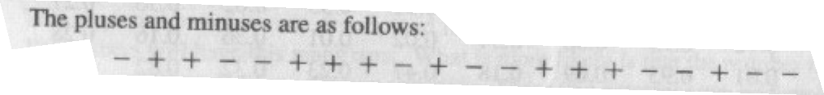
Runs above and below mean
‘+’ denotes an observation is above the mean
‘-’ denotes an observation is below the mean
- + + - - + + + - + - - + + + - - + - -

Slide 6
Runs above and below mean
- + + - - + + + - + - - + + + - - + - -
Run with length 2 and it’s a above the mean run
Run with length 1 and it’s a blow the mean run
There are 11 runs
5 of them above the mean
6 of them below the mean

Slide 7
Runs above and below mean
- + + - - + + + - + - - + + + - - + - -
Let, b = total number of runs (11)
Again
Let n₁ be the no of observations … above the mean (10)
And n₂ be the no of observations … below the mean (10)
Then maximum number of possible runs N=n₁+n₂
And minimum number of runs = one
Given n₁ and n₂ then the mean and variance suggested by Swed and Eisenhart [1943]….

Slide 8
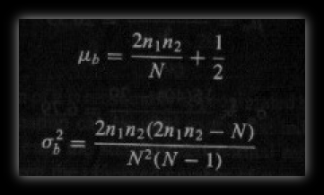
Runs above and below mean
Given n₁ and n₂ then the mean and varience suggested by Swed and Eisenhart [1943]….
Either n₁ or n₂ > 20 … b will be approximated … normal distribution

Slide 9
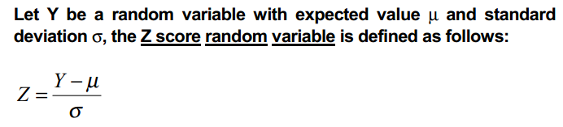
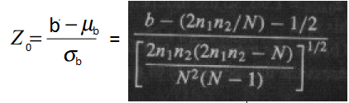
Runs above and below mean
For normal distribution Z-score calculation

Slide 10
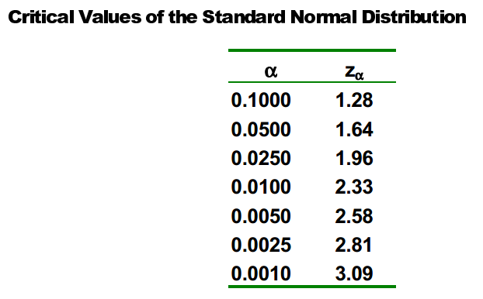
Runs above and below mean
Failure to reject the hypothesis of independence occurs when :
–z_{α/2}≤ Z₀ ≤ z_{α/2}
α → level of significance
α = 0.05 → α/2= 0.025
z_{α/2} → z_{0.025}=1.96

Slide 11
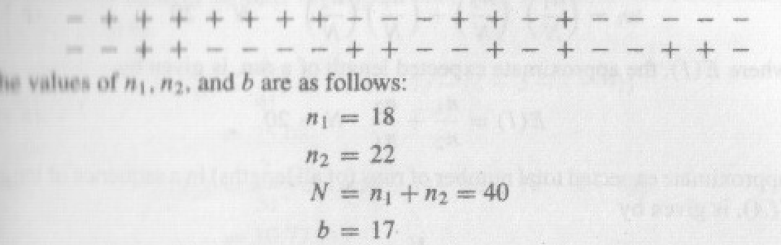
Example

